Slide 1
Session 2

Slide 2
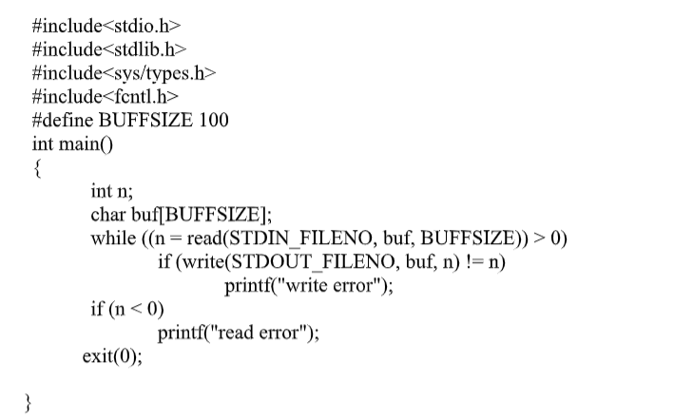
1.Write a C program to read from standard input and display on standard output.

Slide 3
Included Headers:
#include <stdio.h>: This header file is essential for standard input/output operations in C. It provides functions like printf for formatted output, scanf for formatted input, getchar and putchar for single character input/output, fgets and fputs for string input/output, and many others related to file streams.
#include <stdlib.h>: This header offers various utility functions in the C standard library. While not directly used in this particular code, it might contain functions like exit (used in some implementations) or memory allocation functions (like malloc and free) that could be used in a more complex version of this program.
#include <sys/types.h>: This header defines fundamental system data types like pid_t, uid_t, and off_t that might be needed for system calls used in more advanced file or process management scenarios. However, in this specific code, it's not strictly necessary for the core functionality. Open, read, write
#include <fcntl.h>: This header deals with file control operations. While not used in this code, it might be relevant if you wanted to open files with specific flags (e.g., read-only, append mode) in a more advanced version.

Slide 4
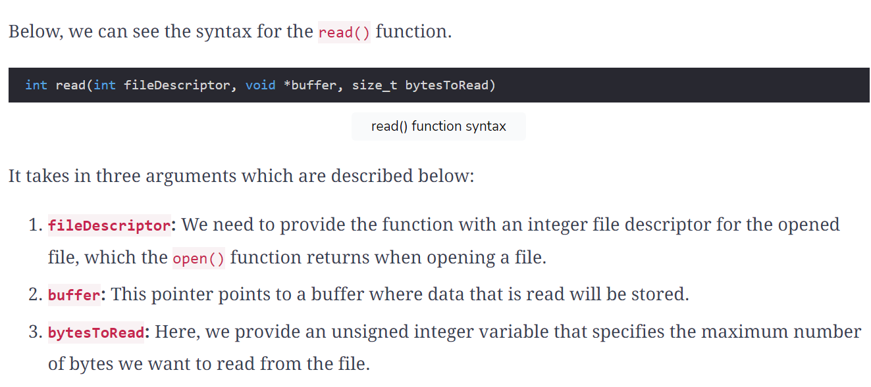

Slide 5
read(STDIN_FILENO, buf, BUFFSIZE): This function attempts to read up to BUFFSIZE bytes from standard input (represented by STDIN_FILENO) and stores the data in the buf array. It returns the number of bytes actually read.
STDIN_FILENO: This is a symbolic constant defined in <unistd.h> that represents the file descriptor for standard input (usually 0).

Slide 6
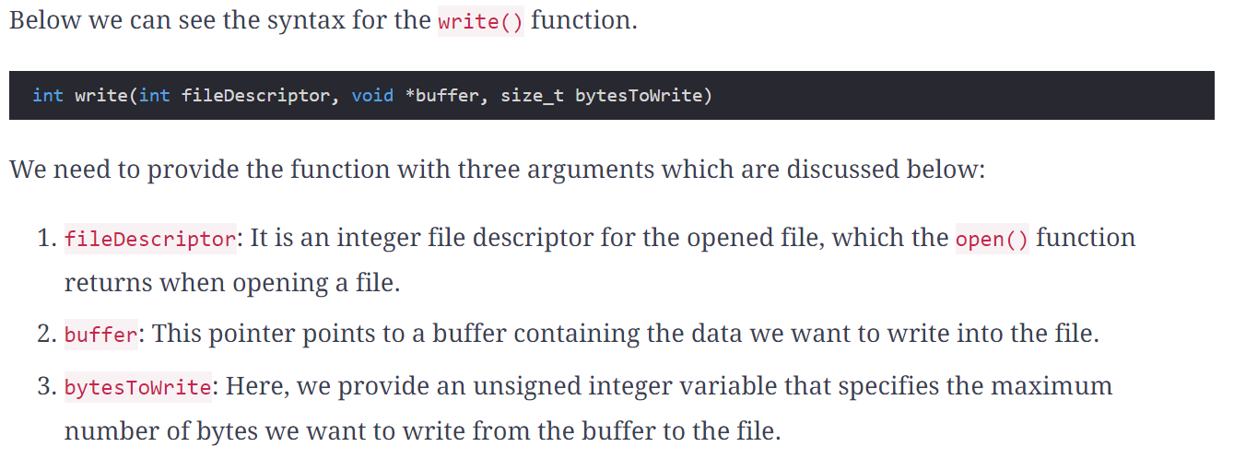

Slide 7
Writing Read Data:
if (write(STDOUT_FILENO, buf, n) != n) printf("write error");: This conditional statement checks if the number of bytes written to standard output (STDOUT_FILENO) using write matches the number of bytes read (n).
write(STDOUT_FILENO, buf, n): This function attempts to write n bytes from the buf array to standard output (represented by STDOUT_FILENO). It returns the number of bytes actually written.
If the number of bytes written (write's return value) doesn't equal n, an error message ("write error") is printed using printf (from <stdio.h>). This indicates a potential problem with writing to standard output.

Slide 8
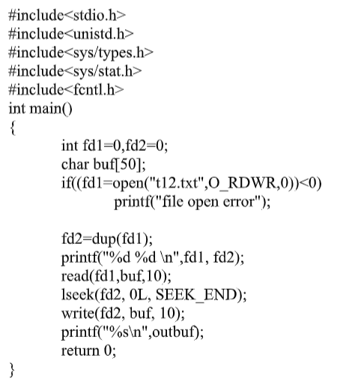
2.Write a program to read n characters from a file and append them back to the same file using dup2 function.

Slide 9
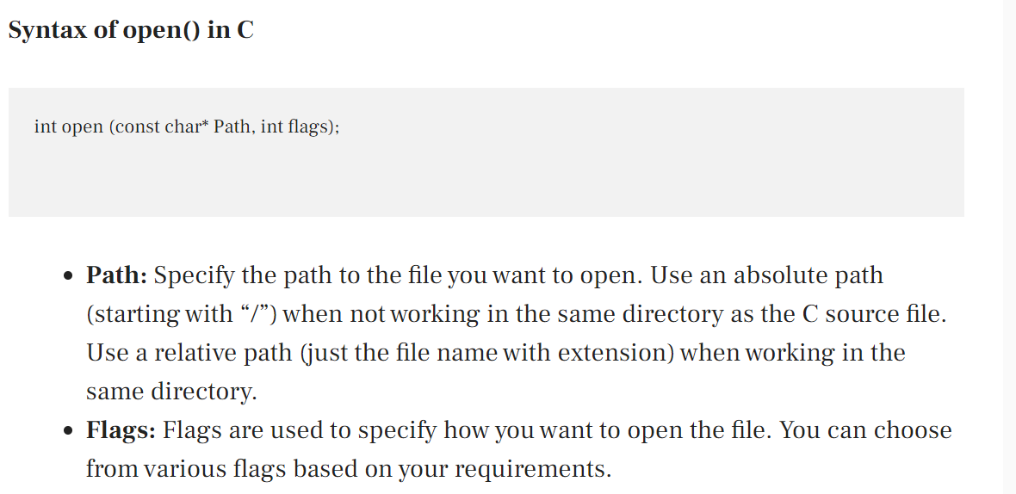

Slide 10
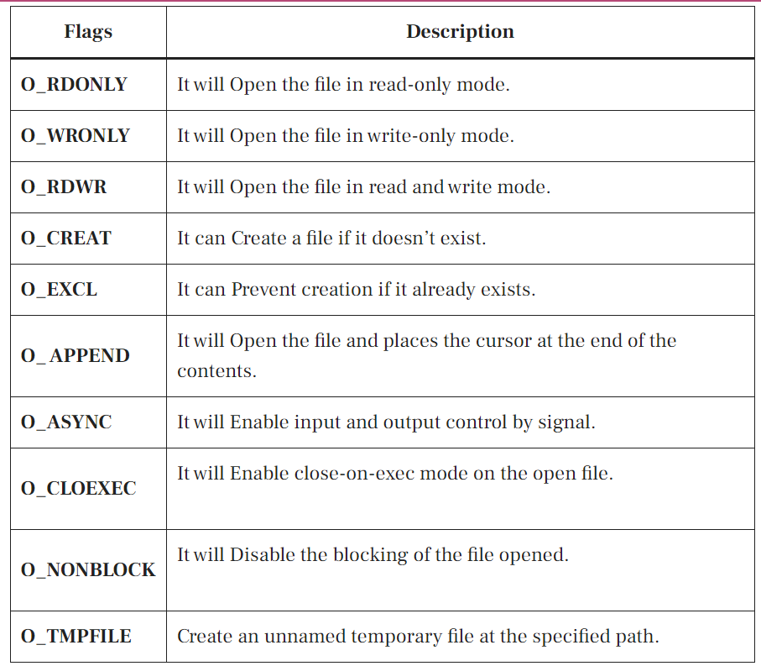

Slide 11
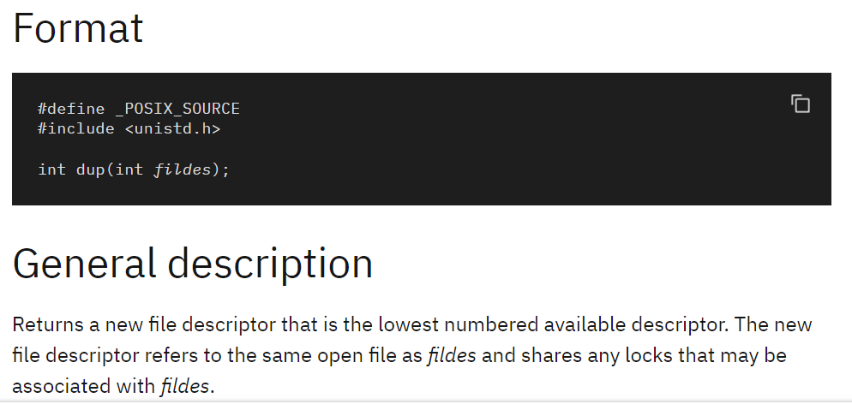

Slide 12
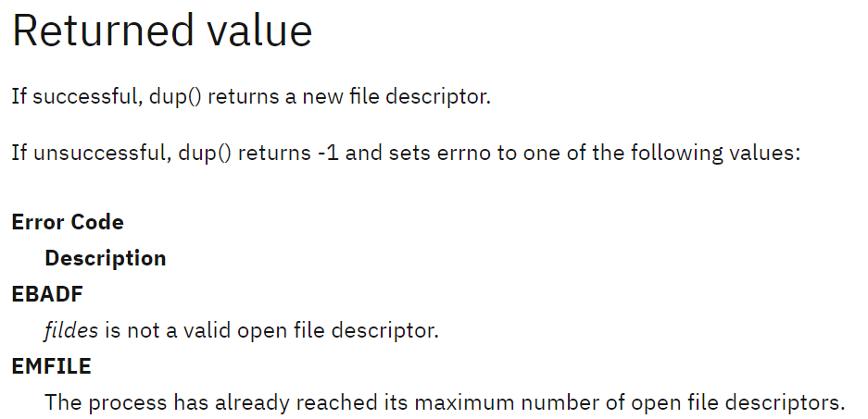

Slide 13
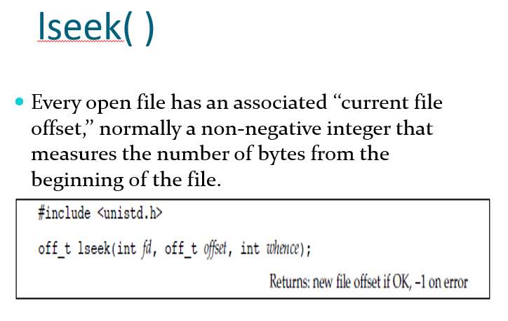

Slide 14
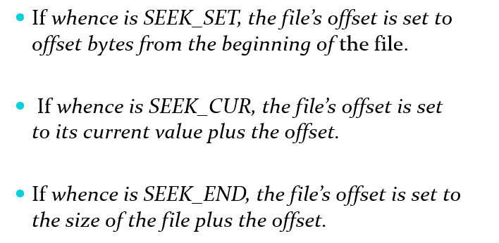

Slide 15
Included Headers:
<stdio.h>: This standard C header file provides functions for standard input/output operations, including printf for formatted output.
<unistd.h>: This header offers various POSIX-compliant system calls, including open, read, write, close, and dup (used in this code).
<sys/types.h>: This header defines fundamental system data types like pid_t, uid_t, and off_t that might be needed for system calls. In this case, it might be necessary for open, read, and write.
<sys/stat.h>: This header typically provides functions for file status operations (stat, lstat, etc.
<fcntl.h>: This header defines file control operations (open, fcntl, etc.). While open is included from <unistd.h>, including both headers might be a practice to ensure all necessary file control constants are available. However, in this specific code, it's not strictly required for the core functionality.

Slide 16
Opening a File:
if ((fd1 = open("t12.txt", O_RDWR, 0)) < 0):
open("t12.txt", O_RDWR, 0): Attempts to open the file "t12.txt" using the open system call (from <unistd.h>).
"t12.txt": The name of the file to open.
O_RDWR: Opening mode flags for both reading and writing.
0: Optional third argument sometimes used for setting permissions (not used here).

Slide 17
Reading from the File (fd1):
read(fd1, buf, 10);: Reads up to 10 bytes from the file referred to by fd1 (which is also fd2) and stores the data in the buf character array.
Seeking to End of File (fd2):
lseek(fd2, 0L, SEEK_END);: This line uses lseek (from <unistd.h>) to reposition the file offset associated with fd2 (which is also fd1) to the end of the file.
0L: The offset value (0 in this case).
SEEK_END: This value indicates seeking relative to the end of the file.
Writing to the File (fd2):
write(fd2, buf, 10);: Attempts to write the 10 bytes stored in buf to the file referred to by fd2 (which is also fd1). However, since lseek positioned the file offset to the end, this write operation will likely append the data to the end of the existing file content.

Slide 18
3. Write a program
to read first 20 characters from a file
seek to 10th byte from the beginning and display 20 characters from there
seek 10 bytes ahead from the current file offset and display 20 characters
display the file size

Slide 19
#include<stdio.h>
#include<unistd.h>
#include<fcntl.h>
#include<sys/types.h>
int main()
{
int file=0, n;
char buffer[25];
if((file=open("testfile.txt",O_RDONLY)) < -1)
printf(“file open error\n”);
if(read(file,buffer,20) != 20)
printf(“file read operation failed\n”);
else
write(STDOUT_FILENO, buffer, 20);
printf("\n");

Slide 20
if(lseek(file,10,SEEK_SET) < 0)
printf(“lseek operation to beginning of file failed\n”);
if(read(file,buffer,20) != 20)
printf(“file read operation failed\n”);
else
write(STDOUT_FILENO, buffer, 20);
printf("\n");

Slide 21
if(lseek(file,10,SEEK_CUR) < 0)
printf(“lseek operation to beginning of file failed\n”);
if(read(file,buffer,20) != 20)
printf(“file read operation failed\n”);
else
write(STDOUT_FILENO, buffer, 20);
printf("\n");
if((n = lseek(file,0,SEEK_END)) <0)
printf(“lseek operation to end of file failed\n”);
printf("size of file is %d bytes\n",n);
close(file);
return 0;
}

Slide 22
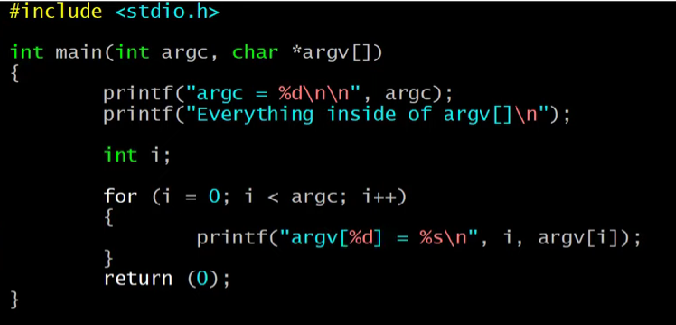
4.Write a program to display the file content in reverse order using lseek system call.
#include<stdlib.h>
#include<stdio.h>
#include<fcntl.h>
#include<string.h>
#include<sys/stat.h>
#include<unistd.h>
int main(int argc, char *argv[])
{
int source, dest, n;
char buf;
int filesize;
int i;
./argument
./argument source dest

Slide 23
if (argc != 3) {
fprintf(stderr, "usage %s <source> <dest>", argv[0]);
exit(-1);
}
if ((source = open(argv[1], O_RDONLY)) < 0)
{ fprintf(stderr, "can't open source\n");
exit(-1);
}
if ((dest = open(argv[2], O_WRONLY | O_CREAT | O_TRUNC)) < 0)
{ fprintf(stderr, "can't create dest\n");
exit(-1);
}

Slide 24
Checking Arguments:
if (argc != 3) { ... }: This if statement checks if the number of command-line arguments (argc) is not equal to 3 (program name, source file, destination file). If not, it prints an error message using fprintf and exits the program with exit(-1).
Opening Source File:
if ((source = open(argv[1], O_RDONLY)) < 0) { ... }: This block attempts to open the source file specified in argv[1] (second argument) in read-only mode (O_RDONLY) using open. If opening fails (indicated by a negative return value), an error message is printed, and the program exits with exit(-1).
Opening Destination File:
if ((dest = open(argv[2], O_WRONLY | O_CREAT | O_TRUNC)) < 0) { ... }: This block attempts to open the destination file specified in argv[2] (third argument) with the following flags:
O_WRONLY: Opens the file for writing only.
O_CREAT: Creates the file if it doesn't exist.
O_TRUNC: If the file exists, truncates it to zero length (effectively deleting its content). If opening fails, an error message is printed, and the program exits.

Slide 25
filesize = lseek(source, (off_t) 0, SEEK_END);
printf("Source file size is %d\n", filesize);
for (i = filesize - 1; i >= 0; i--)
{
lseek(source, (off_t) i, SEEK_SET);
if ((n = read(source, &buf, 1)) != 1)
{
fprintf(stderr, "can't read 1 byte");
exit(-1);
}
if ((n = write(dest, &buf, 1)) != 1)
{
fprintf(stderr, "can't write 1 byte");
exit(-1);
}
}
write(STDOUT_FILENO, "DONE\n", 5);
close(source);
close(dest);
return 0;
}

